Slide 1

Financial Performance Management RBP020L062S
Week 4 Costing, CVP analysis and Pricing decisions

Slide 2
Learning objectives
At the end of this session, you should be able to:
Appreciate the difference between fixed and variable costs.
Understand the importance of cost-volume-profit analysis for an organisation.
Familiarise with the importance of costing information in performance management.

Slide 3
Why do managers want to know the full cost?
Pricing decisions
Outsourcing (make or buy decision)
Planning/Budgeting for the future
Control and benchmarking
Performance evaluation
Responsibility cost measurement systems use responsibility centers as the focal point of cost collection.
A responsibility center is any subunit in the organization that has a manager who is responsible for performance and has a budget.

Slide 4
Cost – the monetary value of the resources sacrificed to achieve a specific objective (FULL COST).
What is a Cost?
What is a Cost Object?
Cost Object – anything for which a separate measurement of costs is desired (e.g., product, service, project, activity, department, etc).

Slide 5
Classification of Costs
On the basis of...
Assignment to a cost object
Direct costs and Indirect costs
Behaviour pattern in relation to changes in the level of a cost driver
Variable costs and Fixed costs
Aggregate or average
Total costs and Unit costs
Assets or expenses (financial statement perspective)
Inventoriable (product) costs and Period costs
Business function
Research and development, Design of products, services and
processes, Production d Marketing, Distribution, Customer service
Manufacturing and non manufacturing costs

Slide 6
Fixed and Variable Costs
Variable cost – changes in total in proportion to changes in the related level of total activity or volume.
Fixed cost – does not change in total despite changes in the related level of total activity or volume.
– Fixed costs become progressively smaller on a per-unit basis as the cost driver increases.
Note: Costs are defined as variable or fixed with respect to a specific cost object and for a given time period.

Slide 7
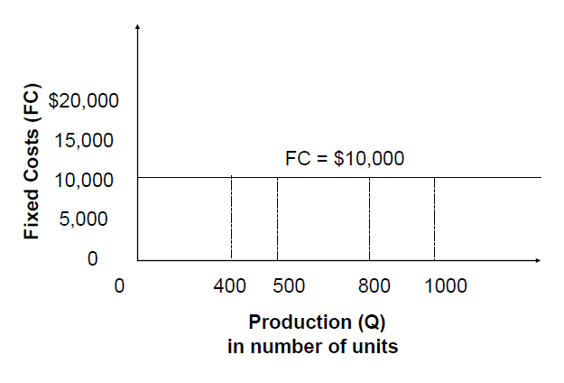
Fixed Costs
Note: a fixed cost is by definition “unchanged” over a
given period of time, but it may vary in the longer term

Slide 8
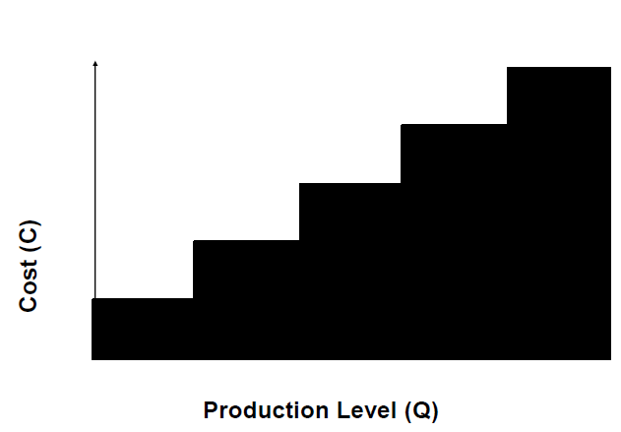
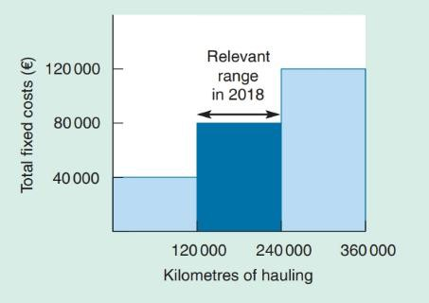
Fixed Costs
STEP COST A cost which is fixed over a certain range of production (quantity) but then increases as the capacity (and the usage of a particular activity) increases

Slide 9
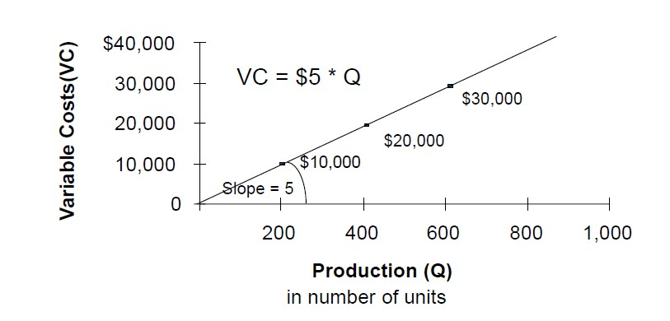
Variable Costs

Slide 10
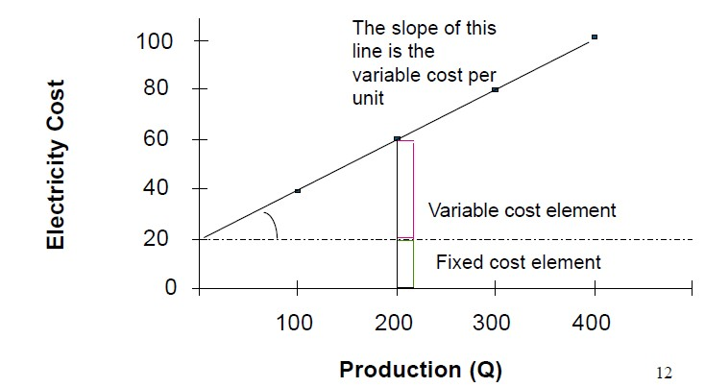
Semi-variable costs
SEMI-VARIABLE A cost which is partially fixed and partially varies with the changes in the level of quantity (activity)

Slide 11
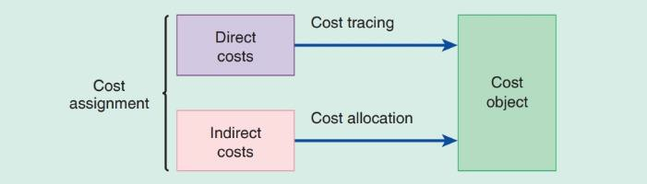
Direct and Indirect Costs
Direct costs of a cost object – are related to the particular cost object and that can be traced to it in an economically feasible (cost- effective) way.
Indirect costs of a cost object –are related to the particular cost object but cannot be traced to it in an economically feasible (cost- effective) way. Indirect costs are allocated to the cost object using a cost-allocation method.
One particular cost may be both direct and indirect. How? The direct/indirect classification depends on the choice of the cost object.

Slide 12
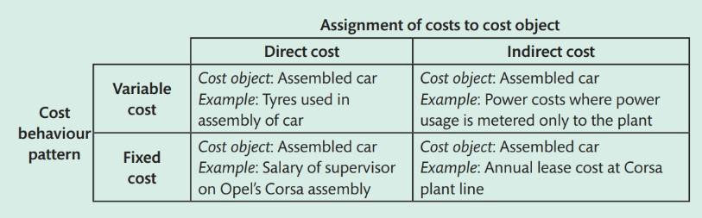
Cost classification
Costs may simultaneously be:
direct and variable, direct and fixed, indirect and variable, indirect and fixed.

Slide 13
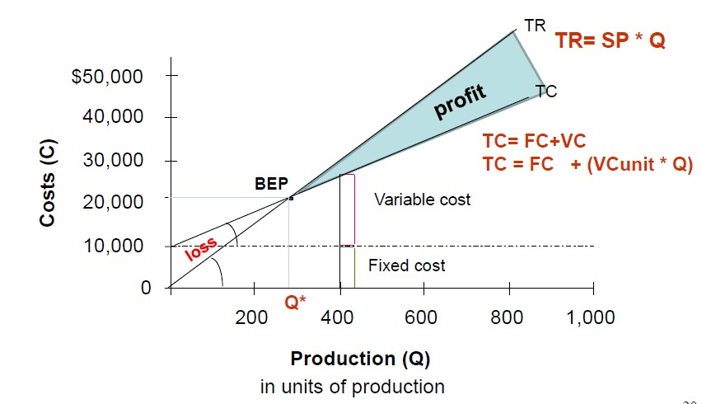
Cost-Volume-Profit Analysis
The breakeven point is that quantity of output where total revenues and total costs are equal, that is, where the operating profit is zero.

Slide 14
CVP analysis: example
Consider the following information:
A product sells for £50 (SPu)
Variable costs are £20 (VCu)
Contribution will be £30 (CMu)
– Obtained as Cmu = Spu – Vcu = £50 - £20
If fixed costs are £3,000… what is the amount of units
required to break even?
𝐹𝑖𝑥𝑒𝑑 𝐶𝑜𝑠𝑡𝑠 3,000
𝐵. 𝐸. 𝑃. (𝑢𝑛𝑖𝑡𝑠) =
= = 100 𝑢𝑛𝑖𝑡𝑠
𝐶𝑀𝑢 30
𝐵. 𝐸. 𝑃. 𝑠𝑎𝑙𝑒𝑠 = 𝐵. 𝐸. 𝑃. 𝑢𝑛𝑖𝑡𝑠 𝑥 𝑆𝑃𝑢 = 100 𝑥 £50 = £5,000
The company needs to sell 100 units to cover the costs (to break even).

Slide 15
CVP analysis: example
Considering that the breakeven point is 100 units and the number of units being sold is 120 per annum, what is the margin of safety as percentage of sales?
𝑀𝑜𝑆 𝑢𝑛𝑖𝑡𝑠 = 𝑆𝑎𝑙𝑒𝑠 𝑢𝑛𝑖𝑡𝑠 − 𝐵. 𝐸. 𝑃. 𝑢𝑛𝑖𝑡𝑠 = 120 − 100 = 20
𝑀𝑜𝑆(𝑢𝑛𝑖𝑡𝑠) 120 − 100
𝑀𝑜𝑆 % =
= = 16.7%
𝑢𝑛𝑖𝑡𝑠 𝑠𝑜𝑙𝑑 120
If the business wishes to make £600 profit, how many units need to be sold?
𝐹𝐶 + 𝑡𝑎𝑟𝑔𝑒𝑡 𝑝𝑟𝑜𝑓𝑖𝑡 3,000 + 600
𝑈𝑛𝑖𝑡𝑠 𝑡𝑜 𝑠𝑒𝑙𝑙 =
= = 120 𝑢𝑛𝑖𝑡𝑠
𝐶𝑀𝑢 30

Slide 16






The role of cost information in pricing decisions
Price takers vs price setters
Market skimming
Penetration pricing
Pricing strategies
Complementary product
Loss leader
Price discrimination

Slide 17

Market skimming
High price for a new high-end product
Achieve maximum revenue before substitutes appear.
Subsequently, lower the price considerably to attract the low-end buyers and to compete with cost cutters and the copycat competitors.

Slide 18



Penetration pricing
Set a low initial price to gain market share and rapid acceptance.
If a high volume is achieved, the low price could be sustainable.
Once market share is achieved, prices are increased.
Volume discount or bulk discount.

Slide 19
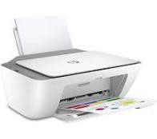

Complimentary product pricing
Major product is priced relatively low to encourage purchase and lock the consumer into subsequent purchases of relatively high price consumables.
Major product is priced relatively high to create barrier to entry and exit and the consumer is locked into subsequent purchases of relatively low-price facilities.

Slide 20



Price discrimination
A strategy where the company sells the same product or services at different prices in different markets for reasons not associated with cost
Seller have some degree of monopoly power.
Customers can be segregated into different markets.

Slide 21

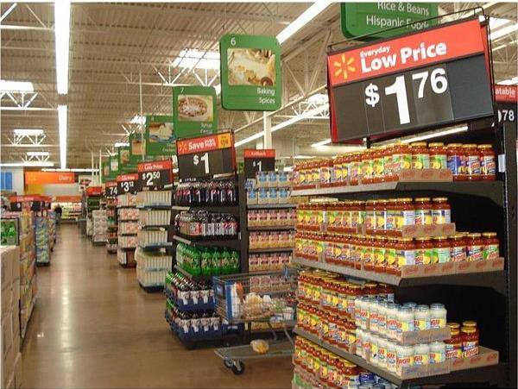
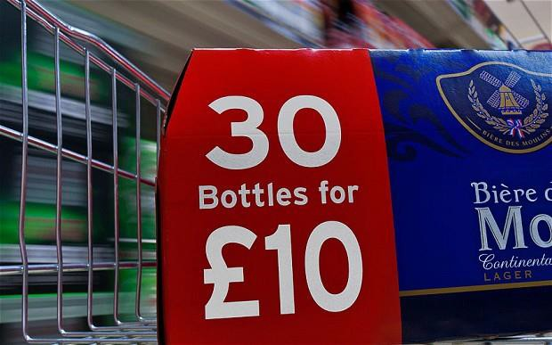
Loss leader strategy
Price below market price / cost.
Purpose: To bring customers in store assuming, customers will be stimulated to buy full priced items as well.
Potential for long term benefit through customer equity.

Slide 22

Seminar this week
Read the Kadgee Clothing case study available on Moodle. Identify cost-cutting ideas (at least five) based on the business scenario and discuss implications for financial performance.
Download the template provided on moodle
33

Slide 23

Readings
Atrill, P. and McLaney, E. (2018). Management Accounting for Decision Makers. Pearson, 9th Edition, Chapter 2-3-4.
IMA (2014). Implementing Activity Based Costing.
Go to Explore section on Moodle and to the Share & Apply seminar

